Slide 1
WELCOME TO MY PRESENTAION Presented By: Hussain Ahmed trainiee ID: 26 Batch: is-10 PROGRAM: EDGE COURESE:IT SUPPORT FOR OFFICE MANAGEMENT
SUBMITTED TO:
MD.FAHMIDUR RAHMAN SAKIB
LECTURER AT DEPARTMENT OF
COMPUTER SCIENCE AND ENGINEERING
METROPOLITA UNIVERSITY

Slide 2
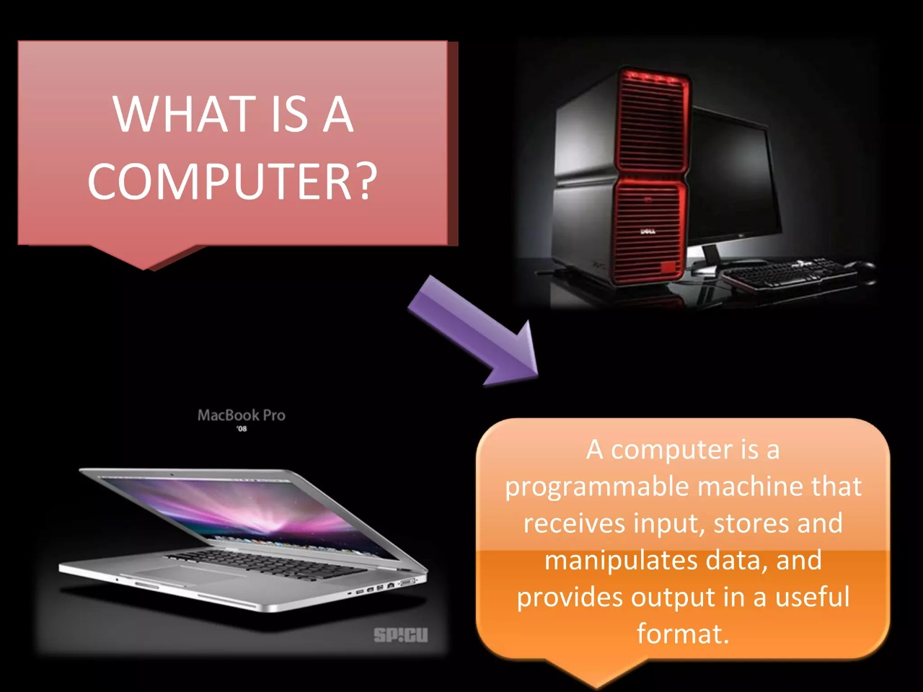

Slide 3
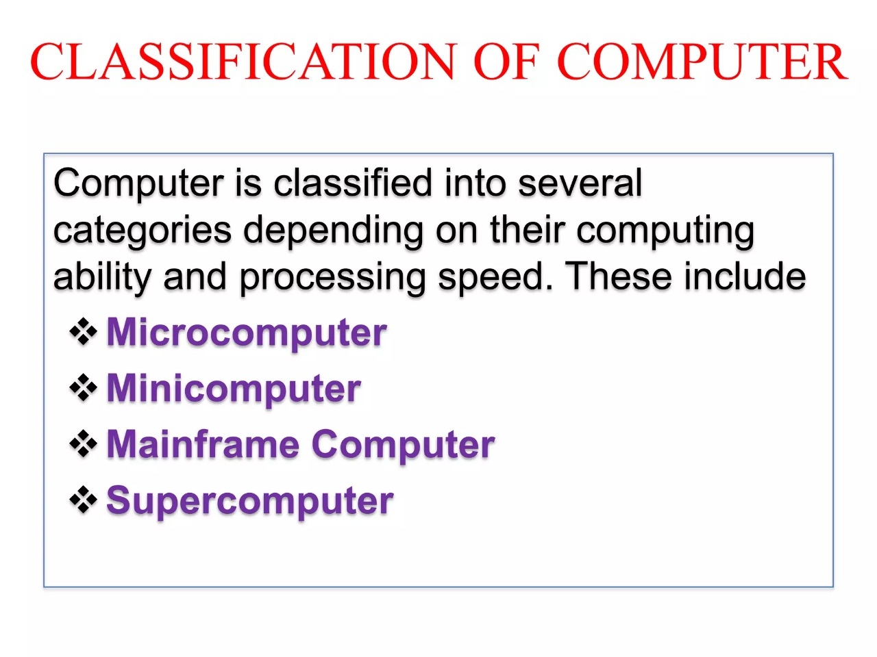

Slide 4
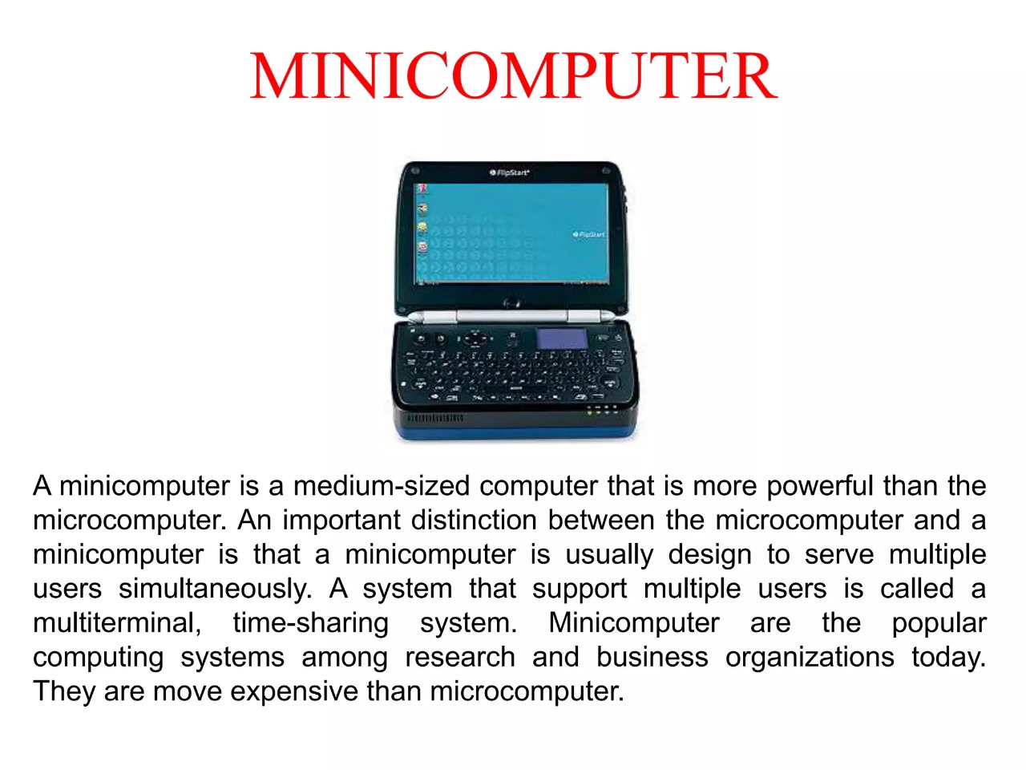

Slide 5
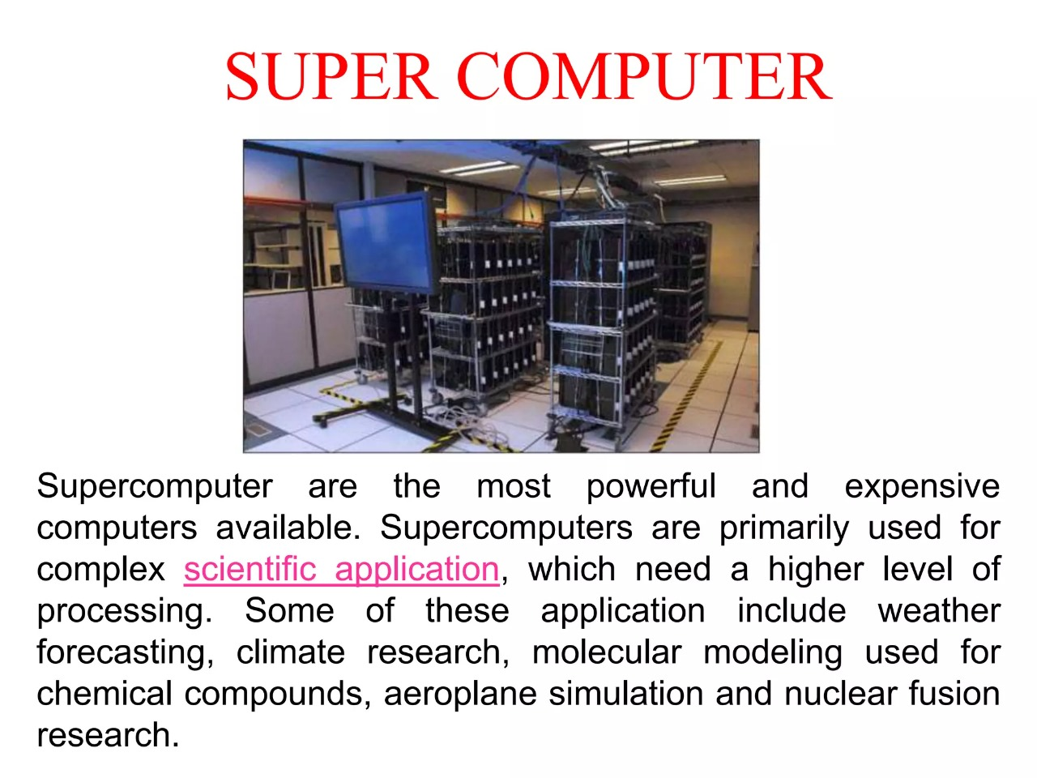

Slide 6
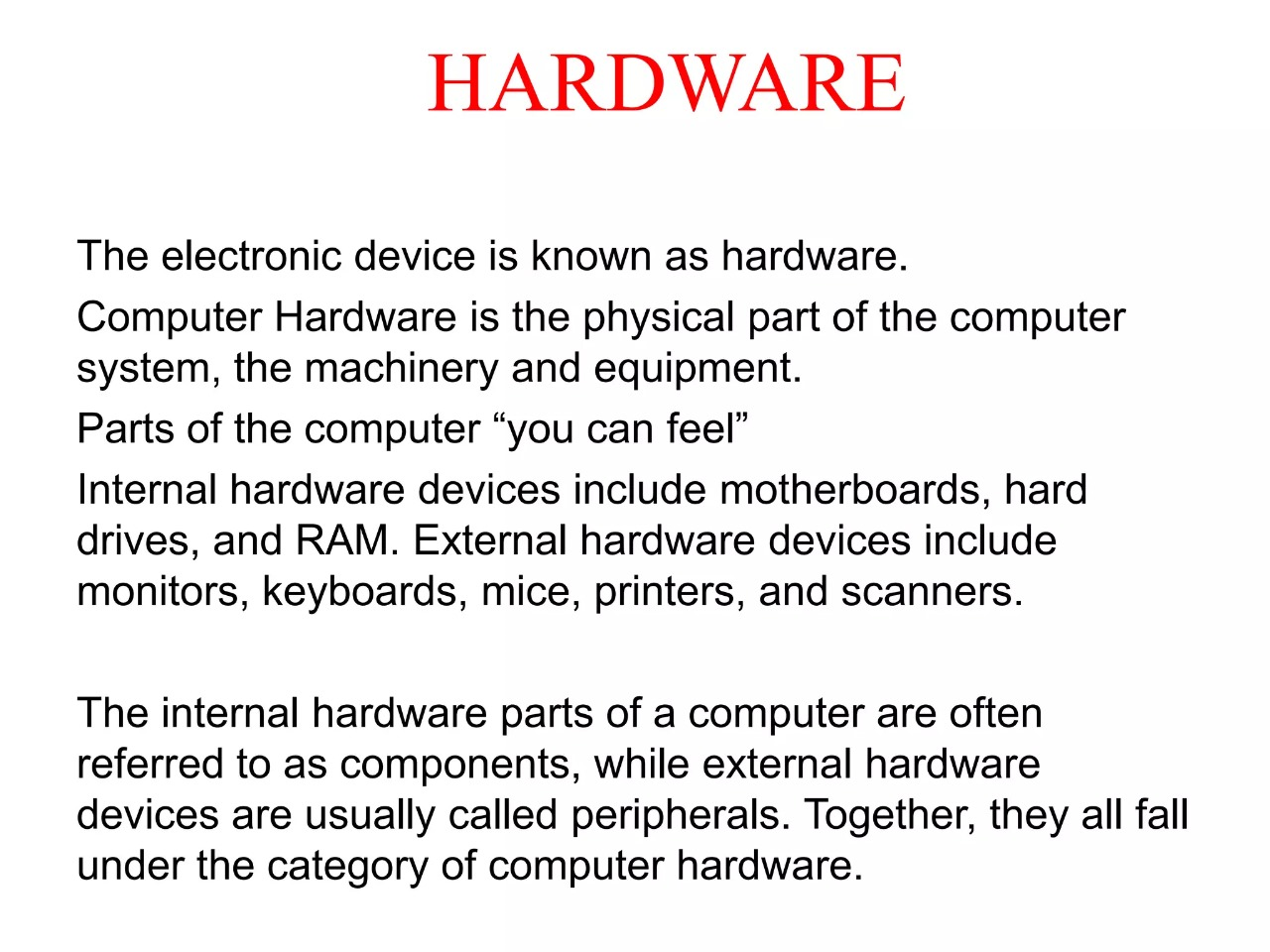

Slide 7
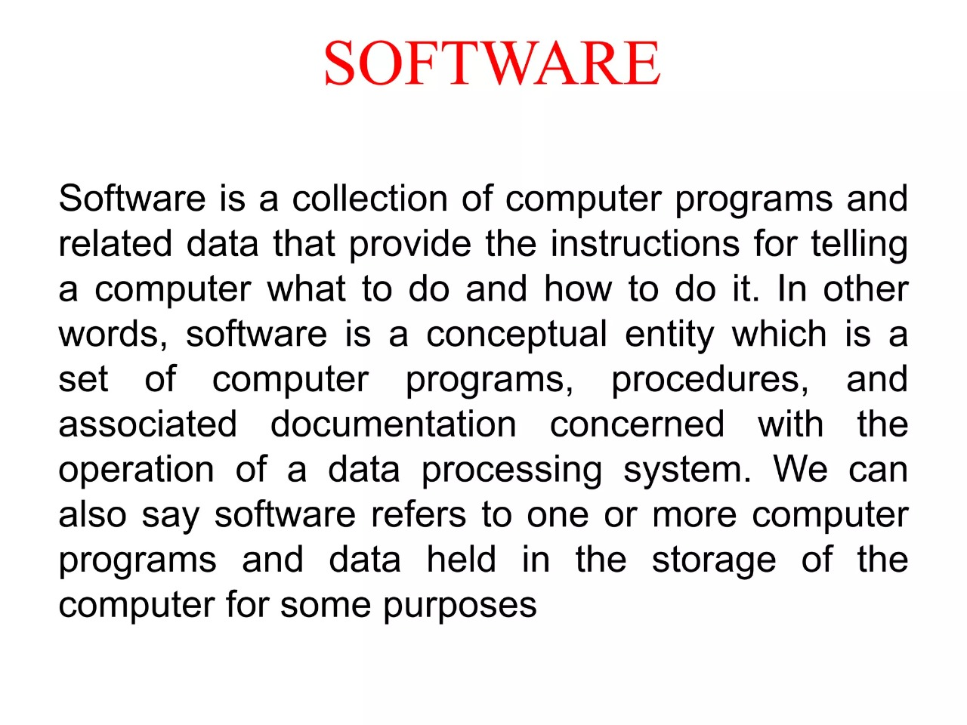

Slide 8


Slide 9


Slide 10
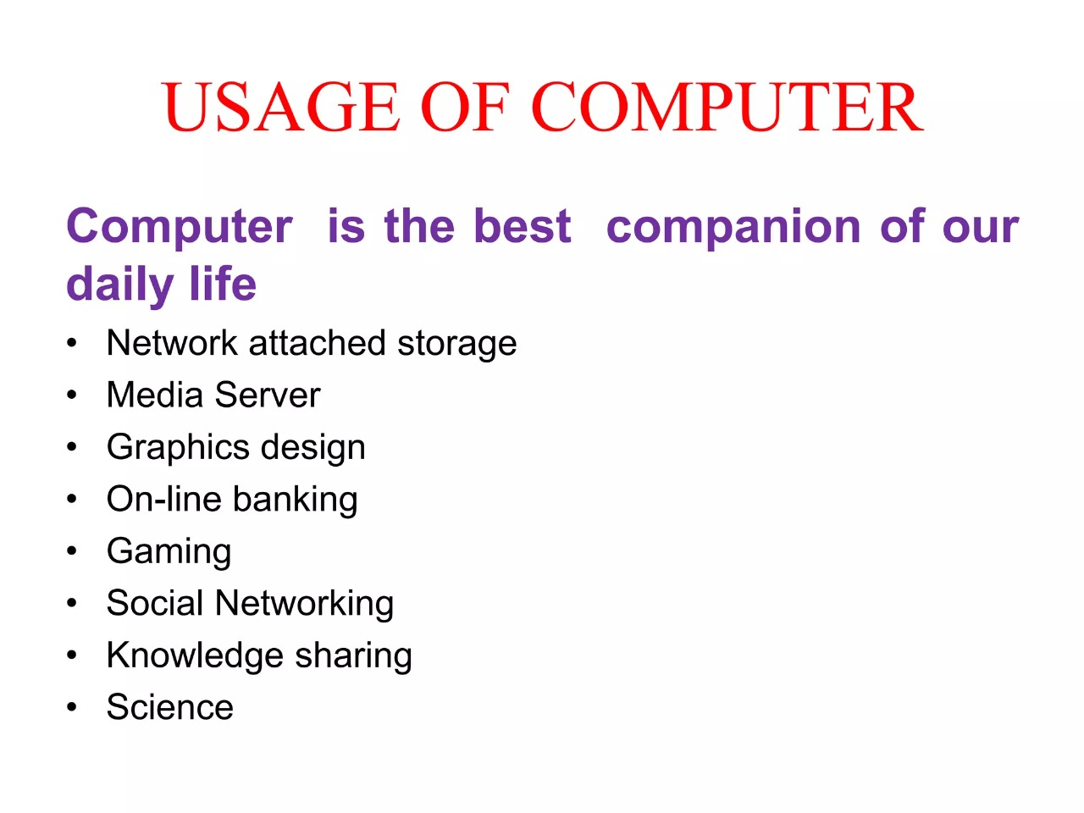

Slide 11
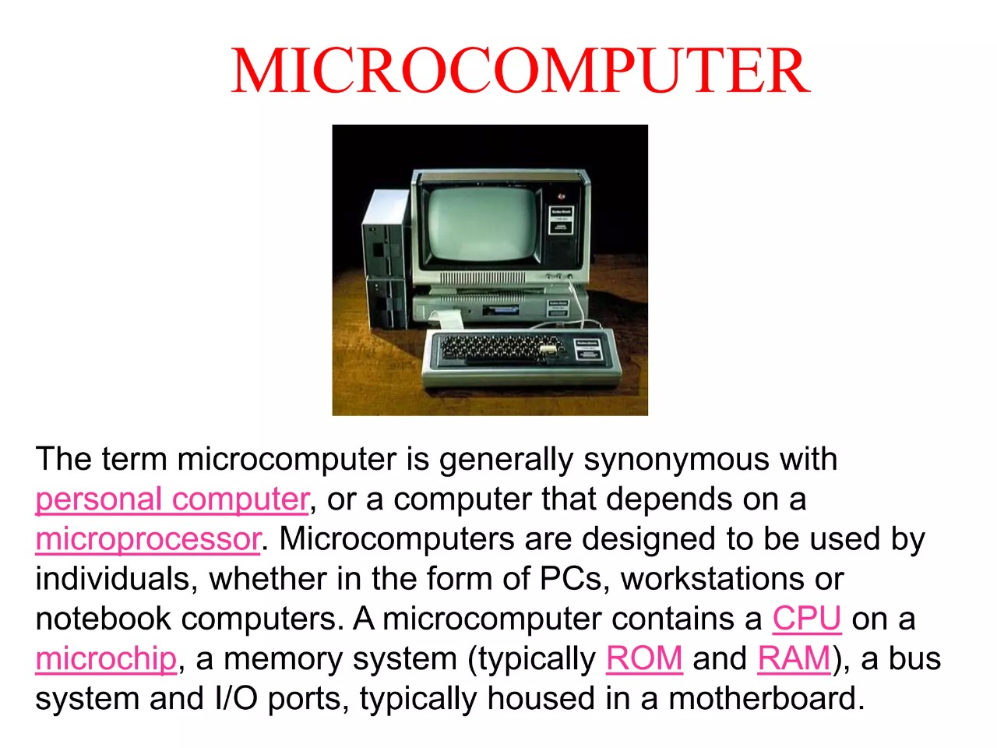

Slide 12


